Slide 1

FORGOTTEN PASSWORD ANALYSIS
Batch Members: Supervisor:
G.SAITEJA (2010030055) Name :- Ms P. Sree Lakshmi
MD.ADNAN (2010030236) Designation:- Assistant professor
G.SAMANTH (2010030272)
K.TRIBHUVAN (2010030402)

Slide 2
Abstract
Given two strings. We have to find the minimum number of steps to convert A
string to B string. We have three operations to perform it.
1) Insert a character
2)Delete a character
3)Replace a character
By using this three operations we have to convert string A to string B
The algorithm we used in these string editing concept we used Levenshtein algorithm to calculates the least number of edit operations that are necessary to modify one string to obtain another string. The most common way of calculating this is by the dynamic programming approach.

Slide 3
Introduction
As now a days in today’s life people are not able to remember the passwords of there applications due to more number of applications and sites have good security so to get correct passwords through the guess of password enter to the model designed to know the minimum possible changes to get right password.
This is possible through dynamic string editing
Dynamic Programming it is mainly an optimization over plain recursion. dynamic programming is both a mathematical optimization method and a computer programming method.
In both contexts it refers to simplifying a complicated problem by breaking it down into simpler sub-problems in a recursive manner.
An optimal transcript is an edit transcript with the minimal number of edit operations for transforming one string into another.
The edit distance problem entails computing the edit distance between two strings along with an optimal transcript

Slide 4
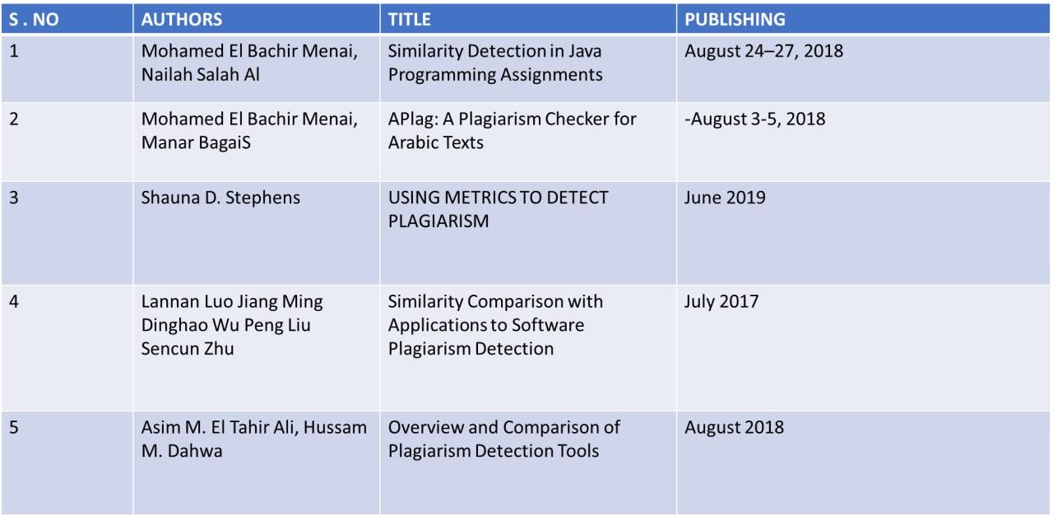
Literature Survey

Slide 5
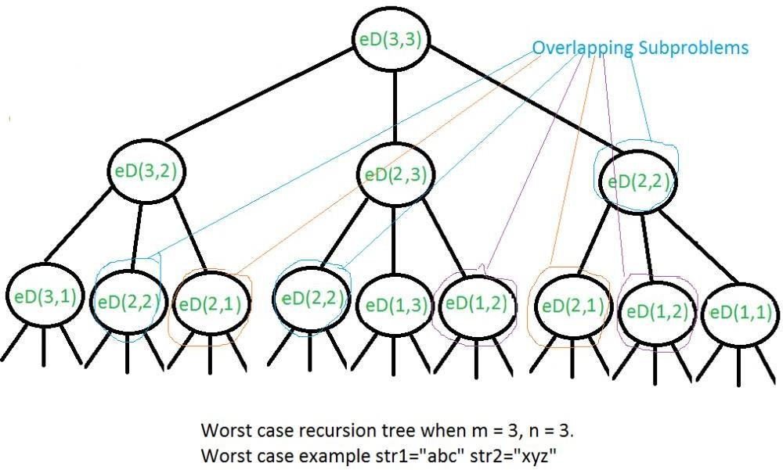
Existing System
Recursion
All the characters of both the strings are traversed one by one either from the left or the right end and apply the given operations.
Time Complexity: O(3^(N * M)), where N and M is the length of the first and second string.
Space Complexity: O(N + M), where N and M is the length of the first and second string

Slide 6
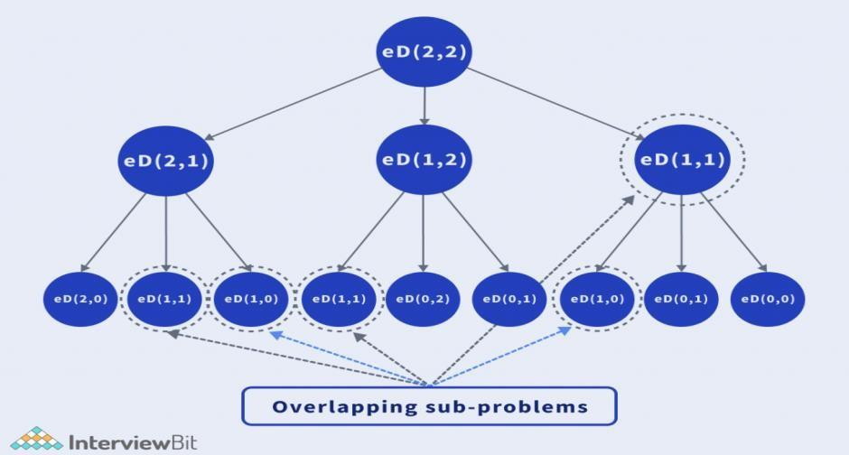
Proposed System
Dynamic programming
The idea is to use a dynamic programming approach here. The tabulation method is the most efficient method to solve this problem. As stated earlier, since the problem has overlapping subproblems, many of the calculations are repeated.
Time Complexity: O(N * M), where N and M is the length of the first and second string.
Space Complexity: O(N * M), where N and M is the length of the first and second string.

Slide 7
Algorithm
LEVENSHTEIN ALGORITHM
The Levenshtein algorithm calculates the least number of edit operations that are necessary to modify one string to obtain another string. The most common way of calculating this is by the dynamic programming approach:
A matrix is initialized measuring in the (m, n) cell the Levenshtein distance between the m-character prefix of one with the n-prefix of the other word.
The matrix can be filled from the upper left to the lower right corner.
Each jump horizontally or vertically corresponds to an insert or a delete, respectively.
The cost is normally set to 1 for each of the operations.
The diagonal jump can cost either one, if the two characters in the row and column do not match else 0, if they match. Each cell always minimizes the cost locally.
This way the number in the lower right corner is the Levenshtein distance between both words.

Slide 8
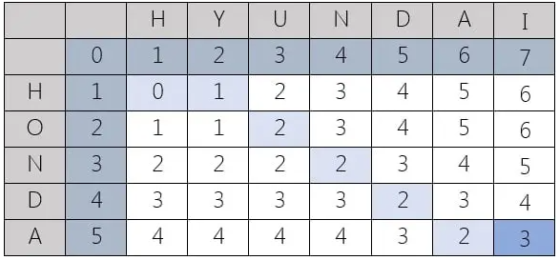
Tabular representation

Slide 9
Software and Hardware Requirements
Software requirements:
The major software requirements of the project are as follows:
Coding Language : Python
Operating system : Windows 10
Tools : Pycharm, Django.
Hardware requirements:
The hardware requirements that map towards the software are as follows:
RAM : 4.00 GB
Processor : Intel(R) Core(TM) i5-4210U CPU @ 1.70GHz 1.70 GHz

Slide 10
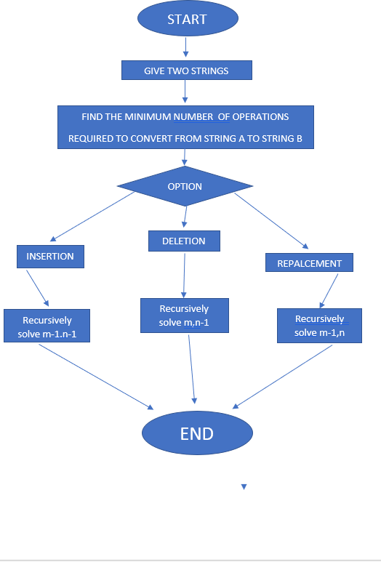
Block Diagram/Architecture

Slide 11
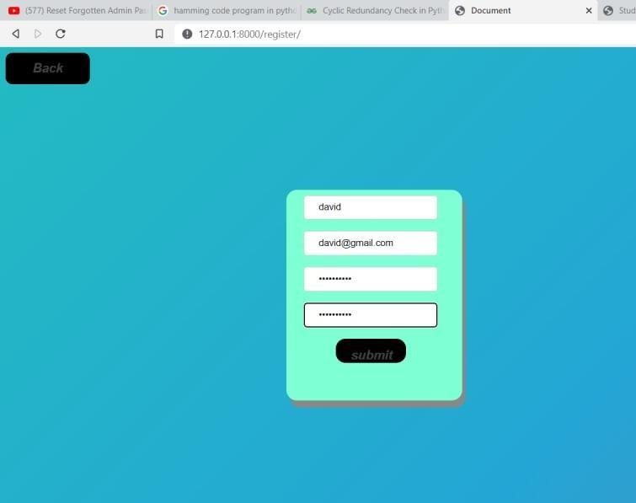
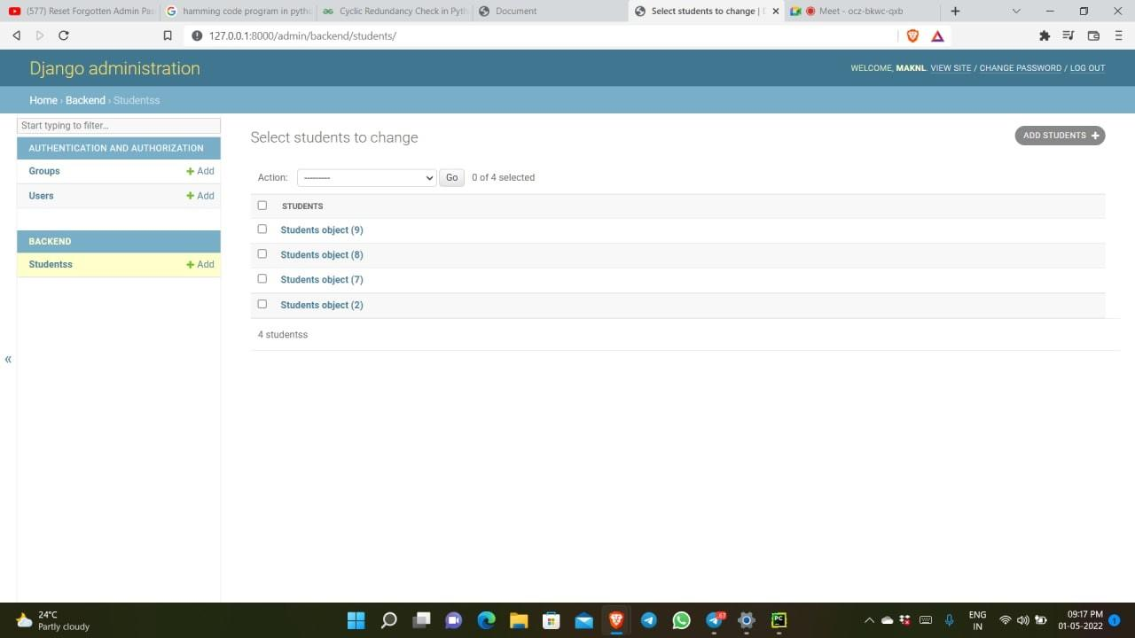
Results

Slide 12
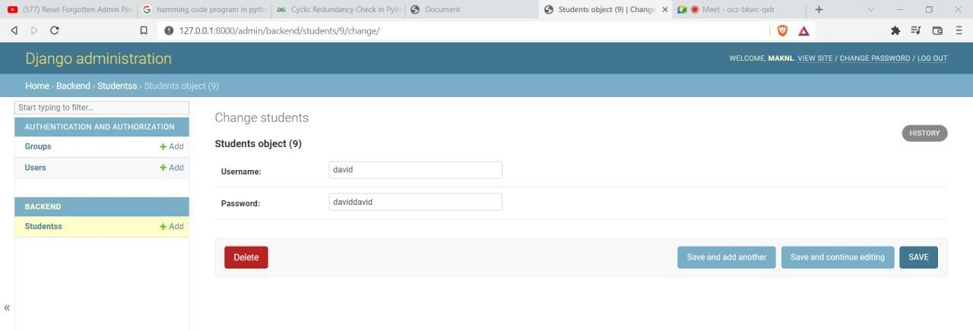
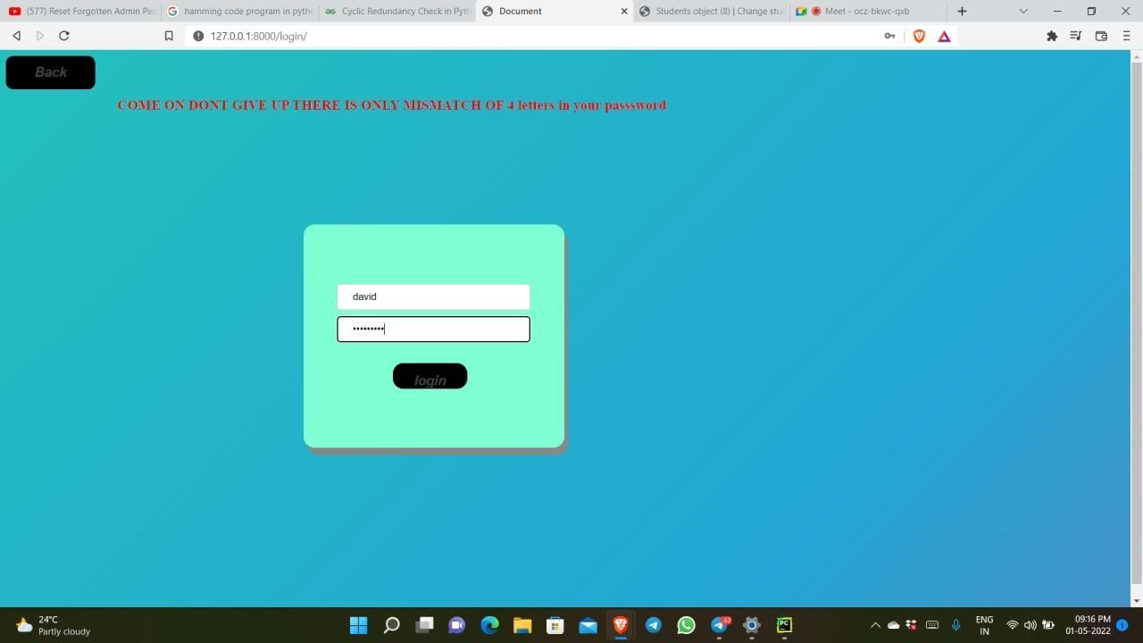
.

Slide 13

.

Slide 14
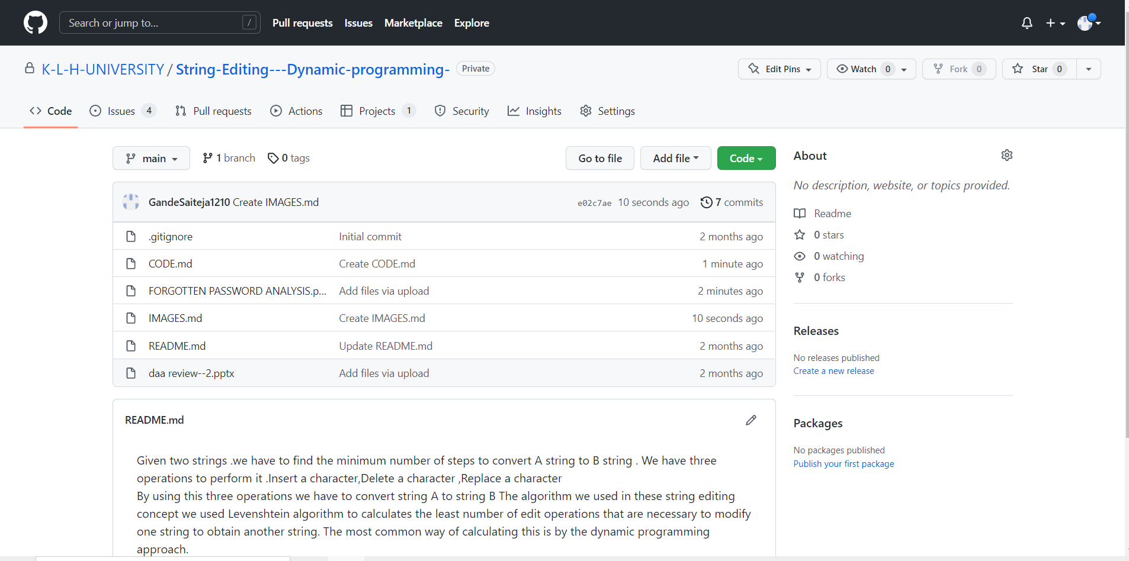
Github Setup

Slide 15
Applications
The real time application of our project is that forgot password program. we use this application in our daily life where we forgot the passwords of our routine applications and sites where this application helps you to recover the password in a easy and secured manner. so to get correct passwords through the guess of password enter to the model designed to know the minimum possible changes to get right password.

Slide 16
Conclusion
In this paper, we present an efficient algorithm to compute the edit distance between a string. By the model designed webpage for forgotten password analysis using string dynamic editing-Any path from (n,m) to (0,0) corresponds to an optimal edit sequence and an optimal alignment . The correspondence between paths and alignments is one-to-one. And insertion , deletion , replacing we able to find how close entered password is to original password and it gives the number of operations need to be done.

Slide 17
Future Scope
We recover all optimal edit sequences and alignments simply by extracting all paths from (n,m) to (0,0)The correspondence between paths and edit sequences is one-to-one. The correspondence between paths and alignments is one-to-one. And insertion , deletion , replacing we able to find how close entered password is to original password and it gives the number of operations need to be done.

Slide 18
References
B. S. Baker. On finding duplication and near-duplication in large software systems. In WCRE’95, pages 86–95, 1995.
G. Balakrishnan and T. Reps. WYSINWYX: What You See Is Not What You eXecute. ACM Transactions on Programming Languages and Systems (TOPLAS), 32(6):23:1–23:84, Aug. 2010.
G. Balakrishnan, T. Reps, D. Melski, and T. Teitelbaum. WYSINWYX: What You See Is Not What You eXecute. In Verified Software: Theories, Tools, Experiments (VSTTE), pages 202–213, • 2005.
C. Cadar, D. Dunbar, and D. Engler. KLEE: Unassisted and automatic generation of high-coverage tests for complex systems programs. In OSDI’08, 2008.
C. Cadar and D. Engler. Execution generated test cases: How to make systems code crash itself. In SPIN’05, 2005

Slide 19
Thank You

